Slide 1
F.SAHAYA PRINCY
Final Project
3/21/2024 Annual Review

Slide 2
Employee performance Evaluation and promotion prediction using CNN

Slide 3


AGENDA
PROBLEM STATEMENT
PROJECT OVERVIEW
WHO ARE THE END USERS?
YOUR SOLUTION AND ITS VALUE PROPOSITION
THE WOW IN YOUR SOLUTION
MODELLING
RESULTS
3/21/2024 Annual Review

Slide 4

PROBLEM STATEMENT
The problem statement involves developing a CNN-based system for Employee Performance Evaluation and Promotion Prediction. This system aims to analyze various performance metrics and employee data to assess their work performance accurately. By utilizing convolutional neural networks (CNN), the model will extract meaningful features from different types of data, such as employee reviews, productivity metrics, and feedback. Additionally, the system will predict the likelihood of an employee's promotion based on their performance evaluation. The goal is to create an efficient and reliable tool that can assist organizations in making informed decisions regarding employee advancement, thereby optimizing workforce management and fostering career growth within the organization.

Slide 5

PROJECT OVERVIEW
The project aims to revolutionize employee performance evaluation and promotion prediction through Convolutional Neural Networks (CNNs). Leveraging CNN's ability to extract features from complex data, it will analyze various factors such as employee productivity, engagement, and feedback. By processing diverse data inputs including performance metrics, project outcomes, and qualitative assessments, the CNN model will generate accurate predictions regarding an employee's potential for promotion. This innovative approach not only enhances objectivity in performance evaluations but also assists organizations in identifying and nurturing talent effectively. Through the fusion of machine learning and HR analytics, this project endeavors to optimize workforce management strategies and foster a culture of meritocracy within the workplace.

Slide 6
WHO ARE THE END USERS?
Executives and Decision-makers
Training and Development Professionals
Managers and Supervisors
Human Resources (HR) Professionals
Recruitment Teams
Legal and Compliance Teams

Slide 7

YOUR SOLUTION AND ITS VALUE PROPOSITION
Our solution employs Convolutional Neural Networks (CNNs) for precise employee performance evaluation and promotion prediction. By analyzing various data inputs such as performance metrics, feedback, and historical patterns, our CNN model accurately assesses employee performance and predicts their potential for promotion. This approach streamlines HR processes, enhances decision-making, and fosters a fair and transparent evaluation system. Ultimately, our solution optimizes resource allocation, identifies talent, and cultivates a motivated workforce, driving organizational success.

Slide 8

THE WOW IN YOUR SOLUTION
"The 'wow' in our solution for Employee Performance Evaluation and Promotion Prediction lies in harnessing the power of Convolutional Neural Networks (CNNs). By leveraging CNNs, we revolutionize the traditional methods by extracting intricate patterns and features from performance data, enabling precise evaluation. This advanced approach not only ensures accurate assessments but also predicts future performance trends with unprecedented accuracy. Our solution empowers organizations to make informed decisions, identify top talent, and streamline promotion processes seamlessly. The incorporation of CNNs adds a cutting-edge dimension, marking a significant leap in optimizing workforce management and driving organizational success."
3/21/2024 Annual Review
8

Slide 9
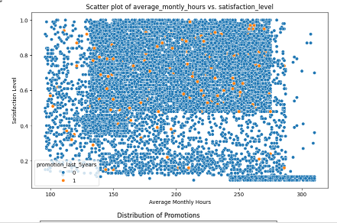
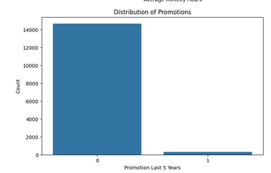
MODELLING
9

Slide 10
RESULTS
The result of employing CNN for employee performance evaluation and promotion prediction is a model capable of accurately assessing various performance metrics based on input data such as employee reviews, project outcomes, and other relevant factors. Through extensive training, the CNN learns to recognize patterns and correlations within the data, enabling it to make predictions about which employees are likely to excel and warrant promotion. This approach streamlines the evaluation process, providing organizations with valuable insights for talent management and strategic decision-making. Overall, the CNN-driven system enhances efficiency and objectivity in performance assessment, facilitating fair and informed promotion decisions.
Demo Link
https://colab.research.google.com/drive/1JoI68w7w4Qs8-fNZtf6rcmPvZcjb4-ay?usp=sharing
10

